Slide 1
Asymptotic Notations
Dr. Khurram S. Khattak

Slide 2

What is Complexity?
The level in difficulty in solving mathematically posed problems as measured by
The time
(time complexity)
number of steps or arithmetic operations
(computational complexity)
memory space required
(space complexity)

Slide 3
Major Factors in Algorithms Design
1. Correctness
An algorithm is said to be correct if
For every input, it halts with correct output.
An incorrect algorithm might not halt at all OR
It might halt with an answer other than desired one.
Correct algorithm solves a computational problem
2. Algorithm Efficiency
Measuring efficiency of an algorithm,
do its analysis i.e. growth rate.
Compare efficiencies of different algorithms for the same problem.

Slide 4
Algorithms Growth Rate
Algorithm Growth Rates
It measures algorithm efficiency
What means by efficient?
If running time is bounded by polynomial in the input
Notations for Asymptotic performance
How running time increases with input size
O, Omega, Theta, etc. for asymptotic running time
These notations defined in terms of functions whose domains are natural numbers
convenient for worst case running time
Algorithms, asymptotically efficient best choice

Slide 5
Complexity Analysis
Algorithm analysis means predicting resources such as
computational time
memory
computer hardware etc
Worst case analysis
Provides an upper bound on running time
An absolute guarantee
Average case analysis
Provides the expected running time
Very useful, but treat with care: what is “average”?
Random (equally likely) inputs
Real-life inputs

Slide 6
Asymptotic Notations Properties
Categorize algorithms based on asymptotic growth rate e.g. linear, quadratic, polynomial, exponential
Ignore small constant and small inputs
Estimate upper bound and lower bound on growth rate of time complexity function
Describe running time of algorithm as n grows to ∞.
Describes behavior of function within the limit.
Limitations
not always useful for analysis on fixed-size inputs.
All results are for sufficiently large inputs.

Slide 7
Algorithm Growth Rates
An algorithm’s time requirements can be measured as a function of the problem size
Algorithm’s growth rate
Enables the comparison of one algorithm with another
Examples
Algorithm A requires time proportional to n²
Algorithm B requires time proportional to n
Algorithm efficiency is typically a concern for large problems only

Slide 8
Algorithm Growth Rates
Figure 10-1
Time requirements as a function of the problem size n

Slide 9
Order-of-Magnitude Analysis
Figure 10-3a
A comparison of growth-rate functions: a) in tabular form

Slide 10
Order-of-Magnitude Analysis
Figure 10-3b
A comparison of growth-rate functions: b) in graphical form

Slide 11
Asymptotic Notations
Asymptotic Notations Θ, O, Ω, o, ω
We use Θ to mean “order exactly”,
O to mean “order at most”,
Ω to mean “order at least”,
o to mean “tight upper bound”,
ω to mean “tight lower bound”,
Define a set of functions: which is in practice used to compare two function sizes.

Slide 12
Algorithm Types
Analysis of Iterative and Recursive Algorithms
Brute Force Algorithms
Recursive Algorithms
Major Algorithm Design Methodologies
Transform & Conquer Algorithms (convert problem to another one)
Divide & Conquer Algorithms
Greedy Algorithms (model objects and their relationships)
Intermezzo
Dynamic Programming (break problem into overlapping sub-problems)
Linear Programming
Constraint Programming
Backtracking Algorithms
Graph Algorithms
Branch & Bound
Iterative Improvement (repeatedly improve current solution)
Randomization (use random numbers)
Other Strategies (Heuristics, String & Numerical Algorithms)
Notes:
12

Slide 13
Real-World Applications
Hardware design: VLSI chips
Compilers
Computer graphics: movies, video games
Routing messages in the Internet
Searching the Web
Distributed file sharing
Computer aided design and manufacturing
Security: e-commerce, voting machines
Multimedia: CD player, DVD, MP3, JPG, HDTV
DNA sequencing, protein folding
and many more!
13
Notes:
13

Slide 14
"Big Oh" Notation
One of the popular notations expressing the relationship between task size and amount of computational resources required.
It provides a model of relative execution time and task size. Therefore, “Big Oh” notation is very useful for classifying levels of computational complexity.

Slide 15
"Big Oh" Notation (cont’d.)
If n = task size (integer, n>0)
f(n) = execution time (>0)
g(n) = relative execution time (asymptotically upper bound)
Then there exists a positive constant c such that
0 ≤ f(n) ≤ c ◦ g(n)
Note the inequality!

Slide 16
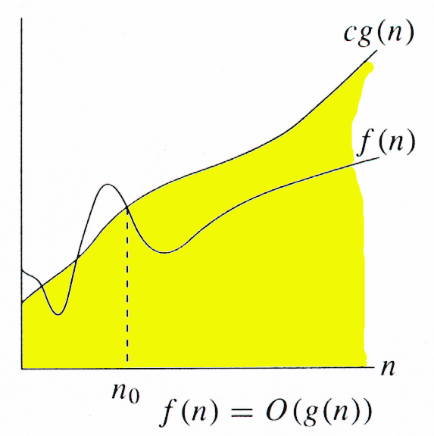
Big-Oh Notation
f(n) ∈ O(g(n))
g(n) is an asymptotic upper bound for f(n).

Slide 17
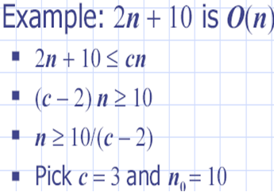
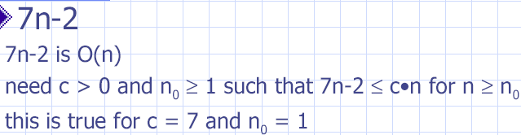
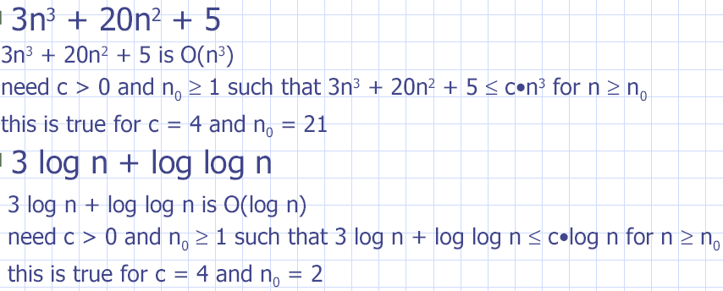

Slide 18
"Big Oh" Notation (cont’d.)
We are interested in upper bound, or worst case, estimates of execution time.
For small values of n, say n<n₀, this may not be true. An extra condition is n≥n₀.

Slide 19
"Big Oh" Notation: O(g(n))
The constant, c, contains machine specific aspects of execution (hardware, compiler, etc.). These aspects are assumed to be independent of task size n (n≥n₀).
The function g(n) represents the trend in execution time for varying values of task size, n.
The notation O(g(n)) signifies "Order of g(n)".

Slide 20
Examples Revisited
Example 1, Part A
The complexity is O(n) with respect to the number of samples taken in the interval [–10,10]
Example 1, Part B
With three variables (N=3), the complexity is O(n³) with respect to the number of samples, n, taken in the interval [–10, 10]

Slide 21
Examples Revisited (cont’d.)
Example 1, Part B
With 10 samples taken in the interval [–10, 10] on each axis, the complexity is O(10^{N}) with respect to the number of variables (axes), N.

Slide 22
Classifications in “Big Oh” Notation
Logarithmic time
O(log(n)): f(n) ≤ c ◦ log(n)
Linear time
O(n): f(n) ≤ c ◦ n
Polynomial time
O(n²): f(n) ≤ c ◦ n²
Exponential time
O(2^{n}): f(n) ≤ c ◦ 2^{n}

Slide 23
Classifications in “Big Oh” Notation (cont’d.)
Factorial time
O(n!): f(n) ≤ c ◦ n!
Double exponential time
O(n^{n}): f(n) ≤ c ◦ n^{n}
Note: “Big Oh” notation is independent of the number of commands a machine executes in a second.

Slide 24
Simplification
What are the “Big Oh” notations for the following?
f(n) = 5n³ + 4n² + 3n + 5
f(n) = 3n³ + 2^{n}
f(n) = 3n + log(n)
f(n) = 6n! + 2n⁴ + n

Slide 25
Simplification – Answers
f(n) = 5n³ + 4n² + 3n + 5 O(n³)
f(n) = 3n³ + 2^{n} O(2^{n})
f(n) = 3n + log(n) O(n)
f(n) = 6n! + 2n⁴ + n O(n!)
Explanations follow.

Slide 26
Simplification – Answers (cont’d.)
f(n) = 5n³ + 4n² + 3n + 5
f(n) = 5n³ + 4n² + 3n + 5
f(n) ≤ 5n³ + 4n³ + 3n³ + 5n³
f(n) ≤ 17n³
f(n) is O(n³)

Slide 27
Simplification – Answers (cont’d.)
f(n) = 3n + log n
log n < n
f(n) ≤ 4n
Therefore, f(n) is O(n)

Slide 28
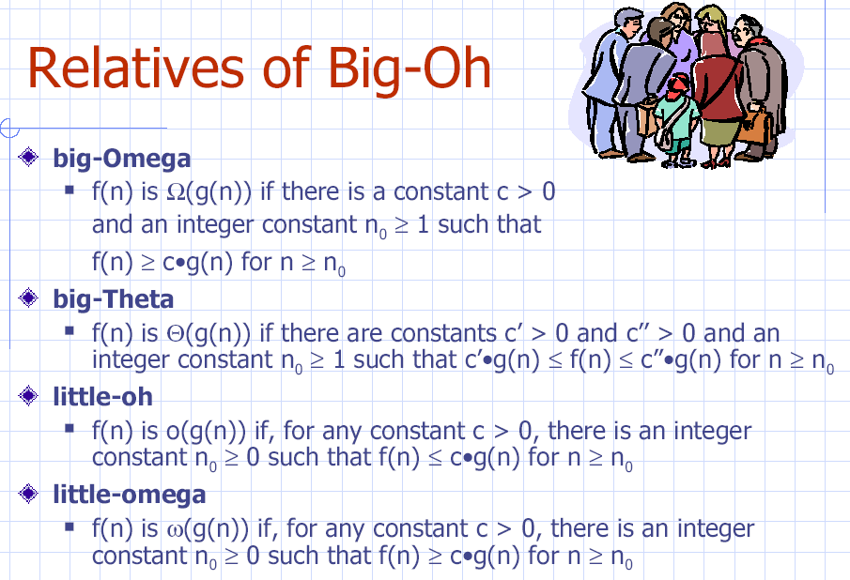

Slide 29
